Slide 1
Machine Learning
Introduction

Slide 2
REINFORCEMENT LEARNING

Slide 3
Reinforcement Learning
In RL, the computer is simply given a goal to achieve.
The computer then learns how to achieve that goal by trial-and-error interactions with its environment
System learns from success and failure, reward and punishment

Slide 4
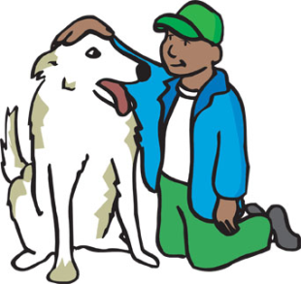


Reinforcement Learning
Similar to training a pet dog
Every time dog does something good you pat him and say ‘good dog’
Every time dog does some thing bad you scold him saying ‘bad dog’
Over time dog will learn to do good things

Slide 5
Learning to Ride a Bicycle
Goal given to RL System - To ride the bicycle without falling over
The RL system begins riding the bicycle and performs a series of actions that result in the bicycle being tilted 45 degrees to the right
At this point two actions possible: turn the handle bars left or turn them right.
RL system turns the handle bars to the left, immediately crashes to the ground, and receives a negative reinforcement.
The RL system has just learned not to turn the handle bars left when tilted 45 degrees to the right

Slide 6
Learning to Ride a Bicycle
RL system turns the handle bars to the RIGHT
Result: CRASH!!!
Receives negative reinforcement
RL system has learned that the “state” of being titled 45 degrees to the right is bad
….

Slide 7
A fancy ML Example

Slide 8
A (Simplified )ML System
Two Modes:
Classification Mode
test
pattern
Preprocessing
Feature
Measurement
Classification
Feature
Extraction/
Selection
training
pattern
Preprocessing
Learning
Training Mode

Slide 9
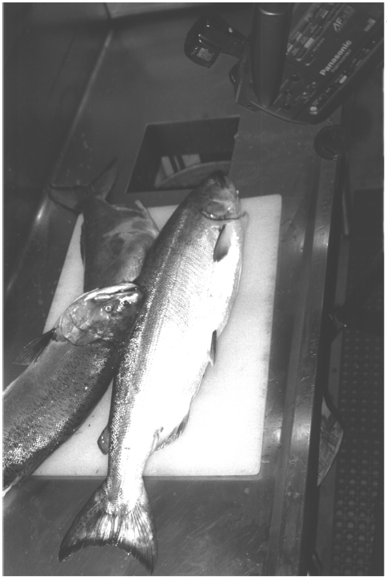
A Fancy problem
Sorting incoming fish on a conveyor according to species (salmon or sea bass) using optical sensing
Salmon or sea bass?
(2 categories or classes)
It is a classification problem. How to solve it?

Slide 10
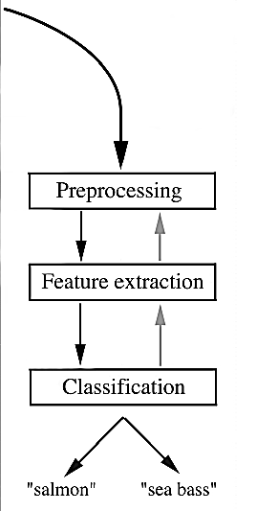
Approach
Data Collection: Take some images using optical sensor

Slide 11
Approach
Data collection
How to use it?
Preprocessing: Use a segmentation operation to isolate fishes from one another and from the background
Information from a single fish is sent to a feature extractor whose purpose is to reduce the data by measuring certain features
But which features to extract?
The features are passed to a classifier that evaluates the evidence and then takes a final decision
How to design and realize a classifier?

Slide 12
Approach
Set up a camera and take some sample images to extract features
Length
Lightness
Width
Number and shape of fins
Position of the mouth, etc…
This is the set of all suggested features to explore for use in our classifier!
Challenges:
Variations in images – lightning, occlusion, camera view angle
Position of the fish on the conveyer belt, etc…

Slide 13
Feature extraction
Feature extraction: use domain knowledge
The sea bass is generally longer than a salmon
The average lightness of sea bass scales is greater than that of salmon
We will use training data in order to learn a classification rule based on these features (length of a fish and average lightness)
Length of fish and average lightness may not be sufficient features i.e. they may not guarantee 100% classification results

Slide 14
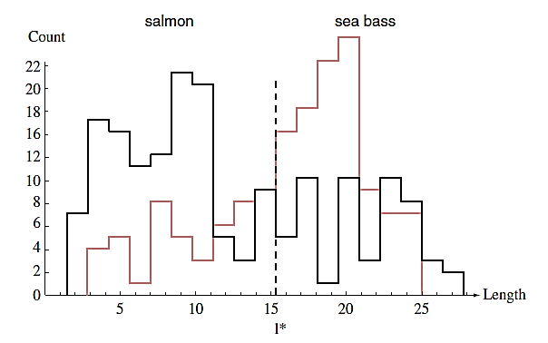
Classification – Option 1
Select the length of the fish as a possible feature for discrimination between two classes
Decision Boundary
Histograms for the length feature for the two categories

Slide 15
Cost of Taking a Decision
A fish-packaging industry use the system to pack fish in cans.
Two facts
People do not want to find sea bass in the cans labeled salmon
People occasionally accepts to find salmon in the cans labeled sea-bass
So the cost of taking a decision in favor of sea bass when the true reality is salmon is not the same as the converse

Slide 16
Evaluation of a classifier
How to evaluate a certain classifier?
Classification error: The percentage of patterns (e.g. fish) that are assigned to wrong category
Choose a classifier that gives minimum classification error
Risk is the total expected cost of decisions
Choose a classifier that minimizes the risk

Slide 17
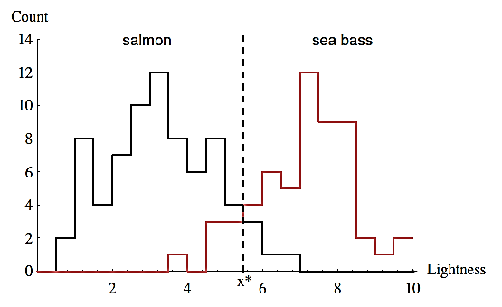
Classification – option 2
Select the average lightness of the fish as a possible feature for discrimination between two classes
Histograms for the average lightness feature for the two categories

Slide 18
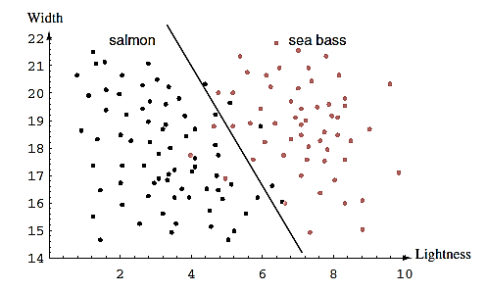
Classification – option 3
Use both length and average lightness features for classification. Use a simple line to discriminate
Decision Boundary
The two features of lightness and width for sea bass and salmon. The dark line might serve as a decision boundary of our classifier

Slide 19
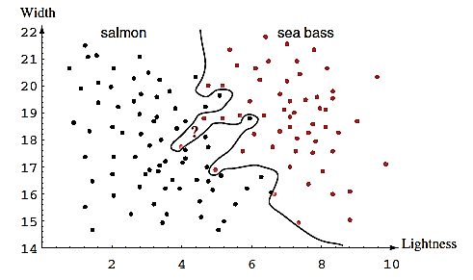
Classification – option 3
Use both length and average lightness features for classification. Use a complex model to discriminate
Overly complex models for the fish will lead to decision boundaries that are complicated. While such a decision may lead to perfect classification (classification error is zero) of our training samples, it would lead to poor performance on future patterns (generalization is poor) → overfitting

Slide 20
Comments
Model selection
A complex model seems not be correct one. It is learning the training data by heart.
So how to choose correct model? (a difficult question)
Occam Razor principle says “simpler models should be preferred over complex ones”
Generalization error
The minimization of classification error on train database does not guarantee minimization of classification error on test database (generalization error)

Slide 21
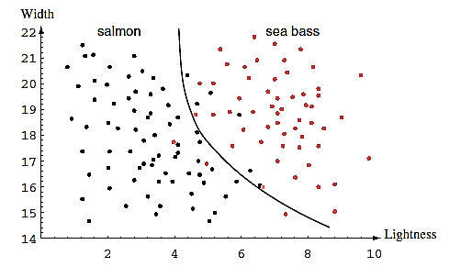
Classification – Option 3
Decision boundary with good generalization
The decision boundary shown might represent the optimal tradeoff between performance on the training set and simplicity of classifier.

Slide 22
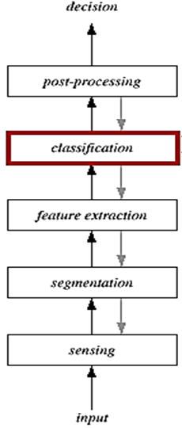
Components of a typical pattern recognition system
Sensing
Use of a sensor (camera or microphone)
Segmentation
Patterns should be well separated and should not overlap
Feature extraction
Feature extraction is a process by which an initial set of data is reduced by identifying key features of the data for machine learning
Discriminative features
Invariant features with respect to translation, rotation and scale
Challenges
Occlusions
Occlusion means that there is something you want to see, but can't due to some property of your sensor setup
Deformations

Slide 23
Components of a typical pattern recognition system
Classification
Use a feature vector provided by a feature extractor to assign the object to a category
The classifier recommends actions (e.g. put this fish in this bucket, put that fish in that bucket)
This stage may employ single or multiple classifiers
Post Processing
The post-processor uses the output of the classifier to decide on the recommended action
Exploit context input dependent information other than from the target pattern itself to improve performance

Slide 24
RESOURCES

Slide 25
Resources - Journals
Pattern Recognition
Pattern Recognition Letters
Journal of Machine Learning Research
Machine Learning
Neurocomputing
Neural Computing and Applications
Neural Networks
Expert Systems with Applications
IEEE Transactions on Neural Networks
IEEE Transactions on Pattern Analysis and Machine Intelligence
...

Slide 26
Resources – Conferences
International Conference of Pattern Recognition (ICPR)
International Conference on Machine Learning (ICML)
European Conference on Machine Learning (ECML)
...

Slide 27


Slide 28
Acknowledgements
The material in these slides has been taken from the following sources
Machine Intelligence, Dr M. Hanif, UET, Lahore
Machine Learning, S. Stock, University of Nebraska
Lecture Slides, Introduction to Machine Learning, E. Alpyadin, MIT Press.
Machine Learning, Andrew Ng – Stanfrod University
Fisher kernels for image representation & generative classification models, Jakob Verbeek

